Slide 1


Statistical Analysis of Measurements
04
01
Measurement and Sensor Technologies
Chang’an University

Slide 2

Statistical Analysis of Measurements
Mean and Median Values
The average value(平均值) of a set of measurements of a constant quantity can be expressed as either the mean value(均值) or the median value(中值). The median value is easier to compute than the mean value because the median computation involves a series of logic operations whereas the mean computation requires addition(加法) and division(除法).
$$x_{mean}=\frac{x_{1}+x_{2}+⋯{+x}_{n}}{n}$$
The median is the middle value when the measurements in the data set are written down in ascending order(递升次序) of magnitude.
Measurement and Sensor Technologies
Chang’an University

Slide 3
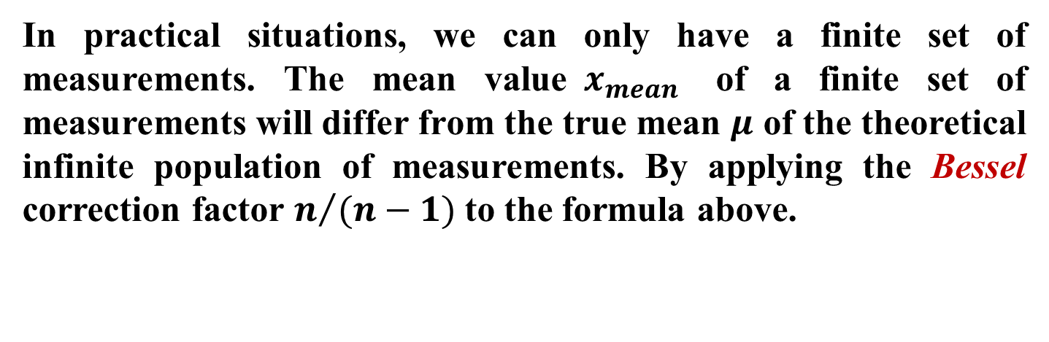


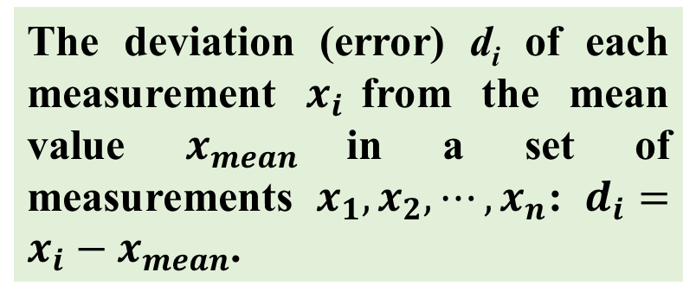

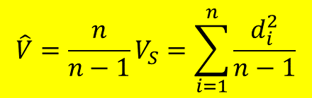
Statistical Analysis of Measurements
Standard Deviation and Variance
The deviation (error) d_{i} of each measurement $x_{i}$from the mean value $x_{mean}$in a set of measurements $x_{1}, x_{2}, ⋯, x_{n}$: $d_{i}=x_{i}−x_{mean}$.
$$V_{S}=\sum_{i=1}^{n}{\frac{d_{i}^{2}}{n}}$$
Variance(方差)
Standard deviation
(标准偏差)
$$σ=\sqrt{V_{S}}=\sqrt{\sum_{i=1}^{n}{\frac{d_{i}^{2}}{n}}}$$
In practical situations, we can only have a finite set of measurements. The mean value${ x}_{mean}$ of a finite set of measurements will differ from the true mean $μ$ of the theoretical infinite population of measurements. By applying the Bessel correction factor $n/{(n−1)}$to the formula above.
$$\hat{σ}=\sqrt{\hat{V}}=\sqrt{\sum_{i=1}^{n}{\frac{d_{i}^{2}}{n−1}}}$$
$${\hat{V}=\frac{n}{n−1}V}_{S}=\sum_{i=1}^{n}{\frac{d_{i}^{2}}{n−1}}$$
Measurement and Sensor Technologies
Chang’an University

Slide 4

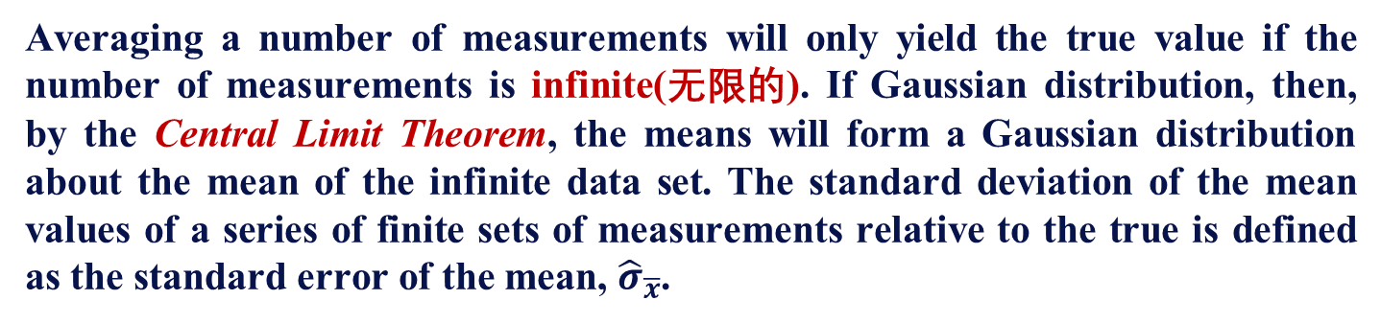
Statistical Analysis of Measurements
Standard Error of the mean
Averaging a number of measurements will only yield the true value if the number of measurements is infinite(无限的). If Gaussian distribution, then, by the Central Limit Theorem, the means will form a Gaussian distribution about the mean of the infinite data set. The standard deviation of the mean values of a series of finite sets of measurements relative to the true is defined as the standard error of the mean, ${\hat{σ}}_{\overline{x}}$.
中心极限定理，是指概率论中讨论随机变量序列部分和分布渐近于正态分布的一类定理。这组定理是数理统计学和误差分析的理论基础，指出了大量随机变量近似服从正态分布的条件。它是概率论中最重要的一类定理，有广泛的实际应用背景。在自然界与生产中，一些现象受到许多相互独立的随机因素的影响，如果每个因素所产生的影响都很微小时，总的影响可以看作是服从正态分布的。
$${\hat{σ}}_{\overline{x}}=\frac{\hat{σ}}{\sqrt{n}}$$
Measurement and Sensor Technologies
Chang’an University

Slide 5
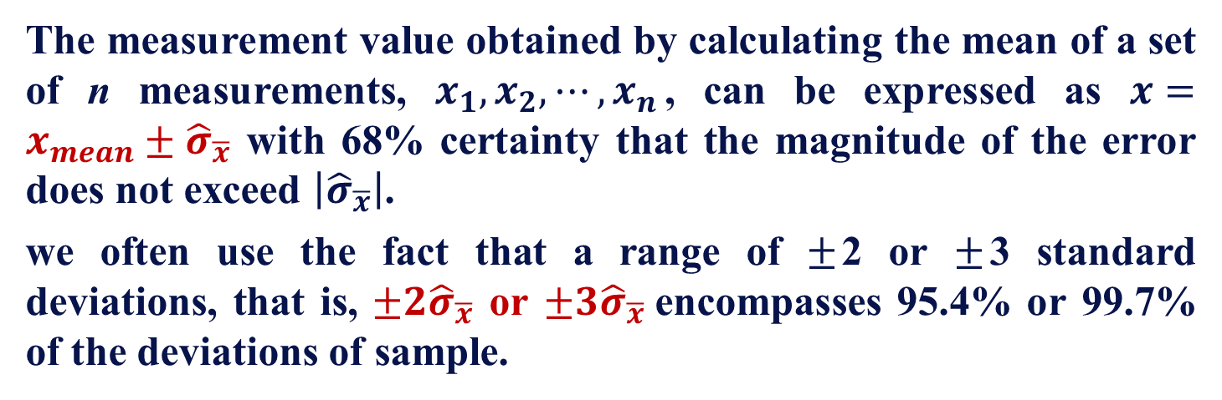
Statistical Analysis of Measurements
Standard Error of the mean
The measurement value obtained by calculating the mean of a set of n measurements, $x_{1}, x_{2}, ⋯, x_{n}$, can be expressed as $x=x_{mean}±{\hat{σ}}_{\overline{x}}$ with 68% certainty that the magnitude of the error does not exceed $\left|{\hat{σ}}_{\overline{x}}\right|$.
we often use the fact that a range of $±$2 or $±$3 standard deviations, that is, ${±2\hat{σ}}_{\overline{x}}$ or ${±3\hat{σ}}_{\overline{x}}$encompasses 95.4% or 99.7% of the deviations of sample.
多组测量情况下对均值估计的偏差计算
Measurement and Sensor Technologies
Chang’an University

Slide 6
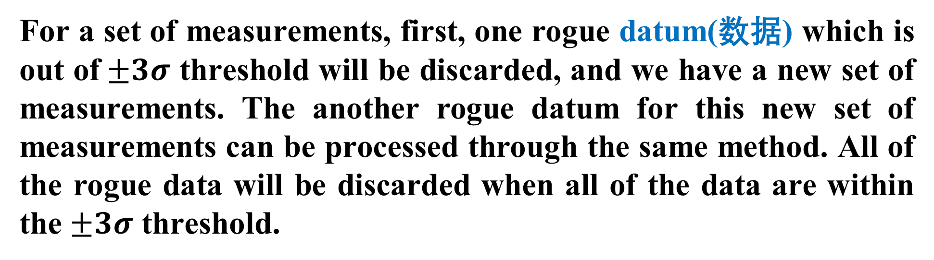
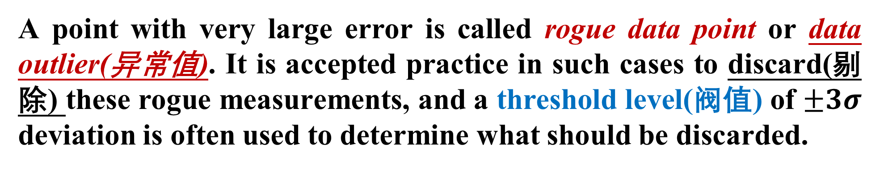
Statistical Analysis of Measurements
Rogue Data Points
A point with very large error is called rogue data point or data outlier(异常值). It is accepted practice in such cases to discard(剔除) these rogue measurements, and a threshold level(阀值) of $±3σ$ deviation is often used to determine what should be discarded.
For a set of measurements, first, one rogue datum(数据) which is out of$±3σ$ threshold will be discarded, and we have a new set of measurements. The another rogue datum for this new set of measurements can be processed through the same method. All of the rogue data will be discarded when all of the data are within the $±3σ$ threshold.
Measurement and Sensor Technologies
Chang’an University

Slide 7
Statistical Analysis of Measurements
Rogue Data Points
粗大误差的判断和剔除
明显与事实不符的异常值 —— 歪曲测量结果 ——剔除
1）物理判别法——测量过程中
人为因素（读错、记录错、操作错）
不符合实验条件/环境突变（突然振动、电磁干扰等）
随时发现，随时剔除 —— 重新测量
在一定的置信概率下确定的置信区间
2）统计判别法——测量完毕
统计方法处理数据 --- 超过误差限 --- 判为异常值 --- 剔除
Measurement and Sensor Technologies
Chang’an University

Slide 8
Statistical Analysis of Measurements
Rogue Data Points
剔除准则(中文P14)
1）拉依达准则（3σ 准则）
测量值的残余误差的绝对值 |γ|> 3σ — 坏值— 剔除
计算算术平均值 x 残余误差 均方误差σ 剔除坏值
2）格罗布斯准则 (举例：中文P15,例1-1)
测量值的残余误差的绝对值| γ |> g(α,n) σ — 坏值— 剔除
g(α,n) ——由重复测量次数n及置信概率P查表确定
Measurement and Sensor Technologies
Chang’an University

Slide 9
Statistical Analysis of Measurements
Aggregation(合成) of Measurement System Errors
Errors in measurement systems often arise from two or more different sources, and these must be aggregated in the correct way in order to obtain a prediction of the total likely error in output readings from the measurement system.
A single measurement component may have both systematic and random errors
A measurement system may consist of several measurement components that each have separate errors.
Measurement and Sensor Technologies
Chang’an University

Slide 10

Statistical Analysis of Measurements
Combined Effect of Systematic and Random Errors
This is the best expression for the error statistically, since it takes account of the reasonable assumption(合理假设) that the systematic and random errors are independent and so it is unlikely to both will be at their maximum or minimum value simultaneously
$$e=\sqrt{e_{s}^{2}+e_{r}^{2}}$$
Measurement and Sensor Technologies
Chang’an University

Slide 11
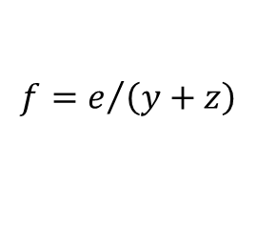



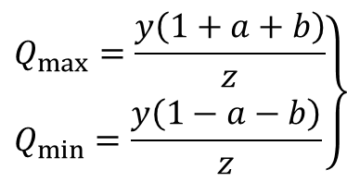

Statistical Analysis of Measurements
Aggregation of Errors from Separate Measurement System Components
Error in a sum
$$S=\left(y+z\right)±e$$
$$S=\left(y+z\right)\left(1±f\right)$$
Error in a difference
$$e=\sqrt{{\left(ay\right)}^{2}+{\left(bz\right)}^{2}}$$
$$f=e/{\left(y+z\right)}$$
Error in a product
$$e=\sqrt{a^{2}+b^{2}}$$
$$\left.\begin{aligned}&Q_{max}=\frac{y\left(1+a+b\right)}{z} \\ &Q_{min}=\frac{y\left(1−a−b\right)}{z}\end{aligned}\right\}$$
Error in a quotient
Measurement and Sensor Technologies
Chang’an University

Slide 12
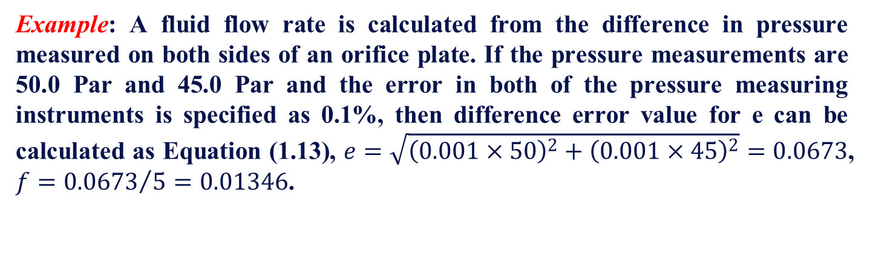
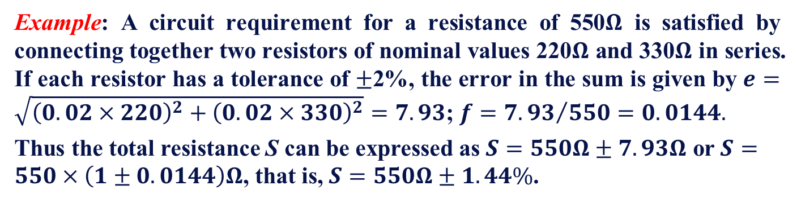
Statistical Analysis of Measurements
Example: A circuit requirement for a resistance of 550$Ω$ is satisfied by connecting together two resistors of nominal values 220$Ω$ and 330$Ω$ in series. If each resistor has a tolerance of $±$2%, the error in the sum is given by $e=\sqrt{{\left(0.02×220\right)}^{2}+{\left(0.02×330\right)}^{2}}=7.93$; $f={7.93}/{550}=0.0144.$
Thus the total resistance S can be expressed as $S=550Ω±7.93Ω$ or $S=550×\left(1±0.0144\right)Ω$, that is, $S=550Ω±1.44\%$.
Example: A fluid flow rate is calculated from the difference in pressure measured on both sides of an orifice plate. If the pressure measurements are 50.0 Par and 45.0 Par and the error in both of the pressure measuring instruments is specified as 0.1%, then difference error value for e can be calculated as Equation (1.13), $e=\sqrt{{\left(0.001×50\right)}^{2}+{\left(0.001×45\right)}^{2}}=0.0673$, $f={0.0673}/5=0.01346$.
Measurement and Sensor Technologies
Chang’an University

Slide 13
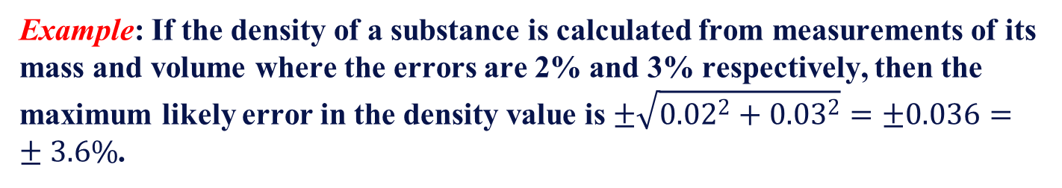
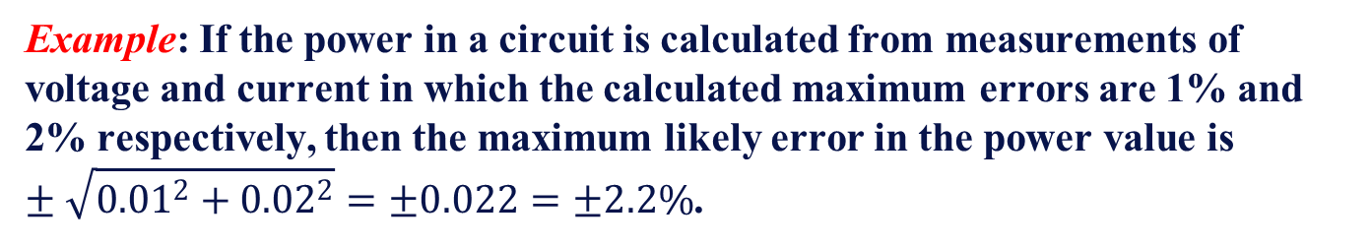
Statistical Analysis of Measurements
Example: If the power in a circuit is calculated from measurements of voltage and current in which the calculated maximum errors are 1% and 2% respectively, then the maximum likely error in the power value is $±\sqrt{0.01^{2}+{0.02}^{2}}=±0.022=±2.2\%$.
Example: If the density of a substance is calculated from measurements of its mass and volume where the errors are 2% and 3% respectively, then the maximum likely error in the density value is $±\sqrt{0.02^{2}+{0.03}^{2}}=±0.036=±3.6\%$.
Measurement and Sensor Technologies
Chang’an University

Slide 14

Statistical Analysis of Measurements
Total Error of Combining Multiple Measurements
Example: A rectangular-sided block has edges of lengths a, b and c, and its mass is m. If the values and possible errors in quantities a, b, c, and m are as shown below, calculate the value of density and the possible error in this value. $a=100mm±1\%$, $b=200mm±1\%$, $c=300mm±1\%$, $m=20kg±0.5\%$.
Solution:
Value of $ab=20000{mm}^{2}±2\%$, possible error $1\%+1\%=2\%$.
Value of $abc=6000000mm^{3}±3\%=0.006m^{3}±3\%$, possible error $2\%+1\%=3\%$.
Value of $m/(abc)=20/0.006=3330kg/m^{3}±3.5\%$, possible error $3\%+0.5\%=3.5\%$.
Measurement and Sensor Technologies
Chang’an University

Slide 15
Mathematical Regression Techniques
05
01
Measurement and Sensor Technologies
Chang’an University

Slide 16
Linear Least Squares Regression
Regression techniques(回归技术) consist of finding a mathematical relationship between measurements of two variables y and x, such that the value of variable y can be predicted from a measurement of the other variable x.
Having determined that the technique is valid, the regression procedure is simplest if a straight-line relationship exists between the variables, which allows a relationship of the form y=a+bx to be estimated by linear least squares(最小二乘法) regression(回归).
Measurement and Sensor Technologies
Chang’an University

Slide 17
Linear Least Squares Regression
回归分析技术有时成为经验，经验公式法就是通过对实验数据的计算，采用数理统计的方法，使用数学表达式表示各变量之间关系——回归方程。
y=a+bx
 | 一元线性回归 | 一元非线性回归 | 多元线性回归 | 多元非线性回归
变量个数 | 1 | 1 | >1 | >1
方次 | 1 | >1 | 1 | >1
有些一元非线性回归可采用变量代换，将其转化为线性回归方程来解。
Measurement and Sensor Technologies
Chang’an University

Slide 18

Linear Least Squares Regression
Linear least squares regression estimates the optimal values(最优值) for the constant coefficients a and b for a set of n measurements, such that the relationship gives the best fit(拟合) to the measurement data.
最小二乘法拟合
$$\left\{\begin{matrix}a=\frac{\sum_{i=1}^{n}{x_{i}}\sum_{i=1}^{n}{\left(x_{i}y_{i}\right)−\sum_{i=1}^{n}{y_{i}}\sum_{i=1}^{n}{x_{i}^{2}}}}{{\left(\sum_{i=1}^{n}{x_{i}}\right)}^{2}−n\sum_{i=1}^{n}{x_{i}^{2}}} \\ b=\frac{\sum_{i=1}^{n}{x_{i}}\sum_{i=1}^{n}{y_{i}−n\sum_{i=1}^{n}{{x_{i}y}_{i}}}}{{\left(\sum_{i=1}^{n}{x_{i}}\right)}^{2}−n\sum_{i=1}^{n}{x_{i}^{2}}}\end{matrix}\right.$$
y=a+bx
Measurement and Sensor Technologies
Chang’an University

Slide 19
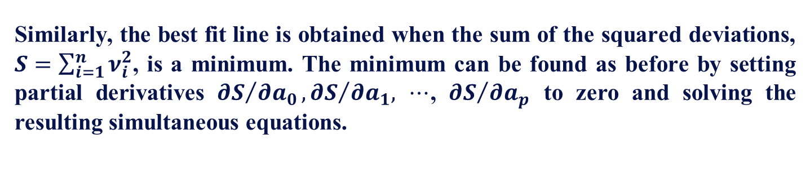
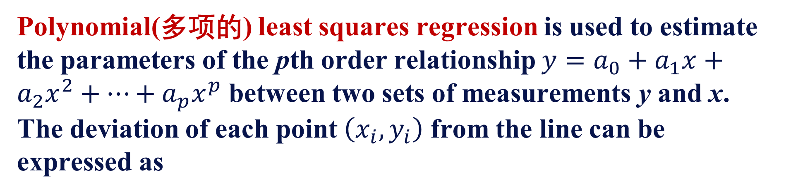
Polynomial Least Squares Regression
Polynomial(多项的) least squares regression is used to estimate the parameters of the pth order relationship $y=a_{0}+a_{1}x+a_{2}x^{2}+⋯+a_{p}x^{p}$ between two sets of measurements y and x. The deviation of each point $\left(x_{i}, y_{i}\right)$ from the line can be expressed as
$$ν_{i}=y_{i}−\left(a_{0}+a_{1}x+a_{2}x^{2}+⋯+a_{p}x^{p}\right)$$
Similarly, the best fit line is obtained when the sum of the squared deviations, $S=\sum_{i=1}^{n}{ν_{i}^{2}}$, is a minimum. The minimum can be found as before by setting partial derivatives ${∂S}/{∂a_{0}}, {∂S}/{∂a_{1}, }$ $⋯$, ${∂S}/{∂a_{p}}$ to zero and solving the resulting simultaneous equations.
By using C, LabView or Matlab
Measurement and Sensor Technologies
Chang’an University

Slide 20
Polynomial Least Squares Regression
Example: The height and weight of 33 students are measured and recorded in meters and kilogram respectively as follows:
Weight/y | 70.3 | 75.2 | 88.1 | 75.0 | 72.8 | 80.7 | 81.3 | 76.6 | 73.8 | 85.2 | 81.2
Height/x | 1.69 | 1.68 | 1.82 | 1.69 | 1.81 | 1.76 | 1.84 | 1.74 | 1.70 | 1.81 | 1.75
Weight/y | 77.3 | 77.9 | 75.3 | 84.7 | 68.5 | 70.7 | 74.4 | 73.0 | 69.4 | 78.8 | 83.5
Height/x | 1.80 | 1.71 | 1.74 | 1.77 | 1.72 | 1.67 | 1.75 | 1.66 | 1.75 | 1.78 | 1.80
Weight/y | 75.5 | 64.2 | 77.2 | 76.1 | 90.6 | 66.6 | 79.5 | 64.1 | 65.8 | 69.4 | 73.5
Height/x | 1.76 | 1.68 | 1.75 | 1.79 | 1.85 | 1.70 | 1.83 | 1.76 | 1.64 | 1.82 | 1.73
Use linear least squares regression to find the optimal values for a, b, c, d in relationships between the variables of the form $y=a+bx$ and $x=c+dy$.
Measurement and Sensor Technologies
Chang’an University

Slide 21
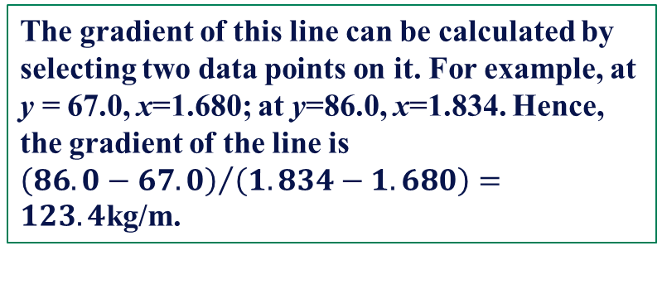
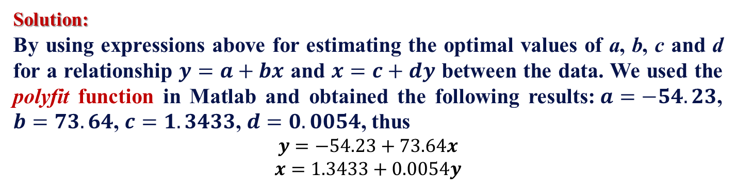
Polynomial Least Squares Regression
Solution:
By using expressions above for estimating the optimal values of a, b, c and d for a relationship $y=a+bx$ and $x=c+dy$ between the data. We used the polyfit function in Matlab and obtained the following results:$a=−54.23$, $b=73.64$, $c=1.3433$, $d=0.0054$, thus
$$y=−54.23+73.64x$$
$$x=1.3433+0.0054y$$
The gradient of this line can be calculated by selecting two data points on it. For example, at y = 67.0, x=1.680; at y=86.0, x=1.834. Hence, the gradient of the line is ${\left(86.0−67.0\right)}/{\left(1.834−1.680\right)}=123.4$kg/m.
Measurement and Sensor Technologies
Chang’an University

Slide 22
Summary
Gave the definitions of measurement, metrology and testing.
Three uncertainty evaluations, i.e. standard, combined standard and expanded evaluations.
Two engineering defined measurement errors: systematic error and random error.
The variable called the standard error of the mean.
The presence of rogue data points (data outliers) in the measurement data.
How the effect of different measurement errors are aggregated.
Two mathematic regression techniques: linear least squares regression and polynomial least squares regression.
Measurement and Sensor Technologies
Chang’an University

Slide 23
Homework
TRUE or FALSE: ALL
Fill-in-the-blanks: ALL
Problems: (6), (10)
Due Date: After one week
Measurement and Sensor Technologies
Chang’an University

